Slide 1

METAL REINFORCED POLYMER PIPES
INNOVATIVE TECHNOLOGY PRESENTATION

Slide 2


ABOUT MEPOS
Company established in 1990
Technology developed for uranium heap leaching on depths up to 800 meters
Production facility is located in Yekaterinburg, Russia
Internationally patented technology
Approved service life of 20+ years by largest Russian companies
More than 2000 kilometers of pipelines laid in various industries
Production capacity is 240 000 meters/year
Rapid technology developments, research database of different materials applied

Slide 3
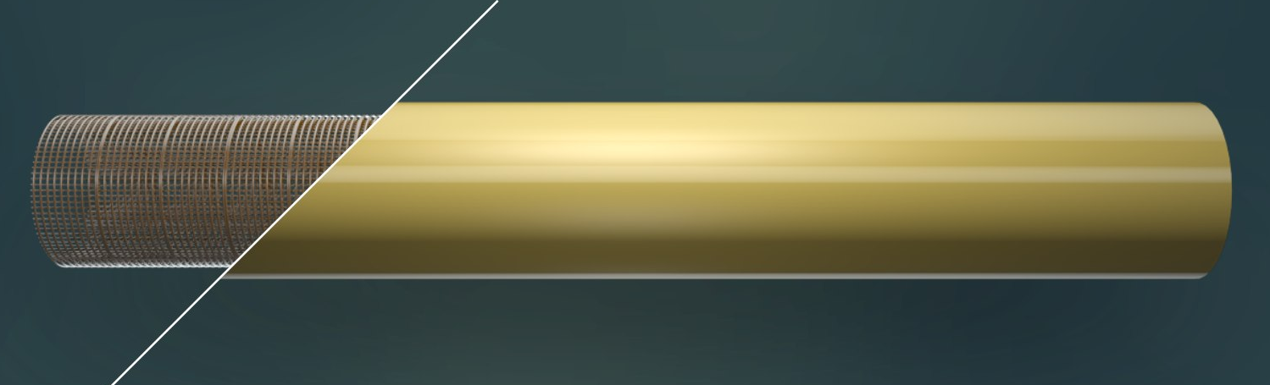
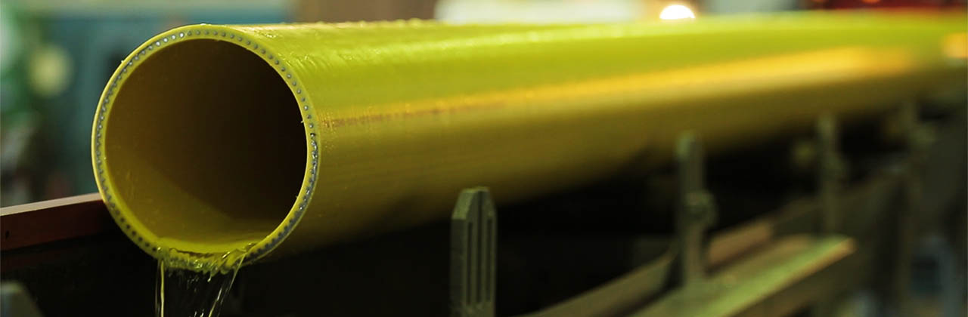
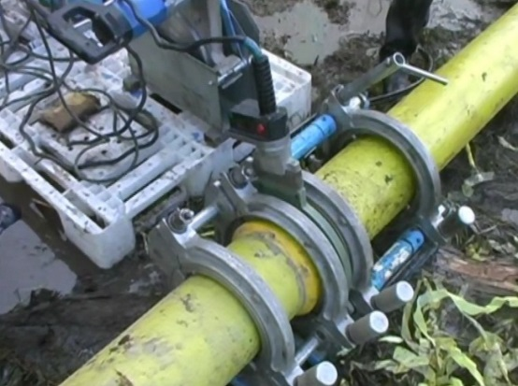
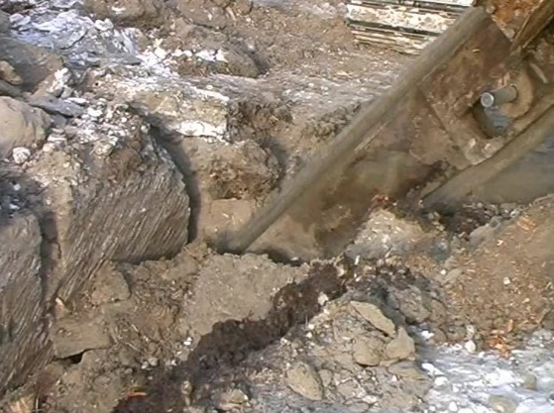
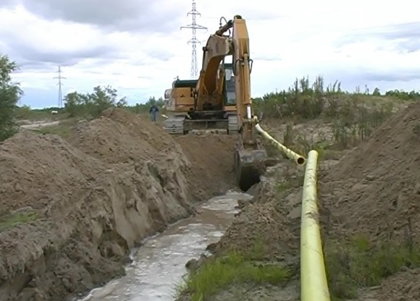
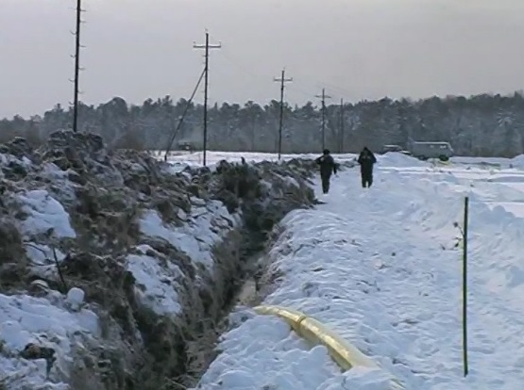
WHAT IS METAL REINFORCED POLYMER PIPE
A rigid lattice frame welded from steel wire shapes an MRPP. This frame is surrounded by a layer of polymer material, which forms inner and outer surfaces of an MRPP.
Key features of MRPP:
MRPP combines advantages of both – steel and polymer pipes
As strong as steel pipe withstand higher pressures than regular polymer pipe
Resistant to chemically-aggressive fluids higher durability in transportation of highly aggressive liquids
100% resistant to corrosion no need in anti-corrosion treatment, inhibitory protection, cathode protection
Possibility of various polymers application increases application areas

Slide 4
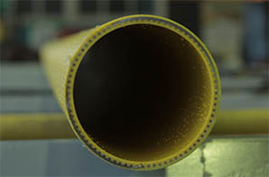
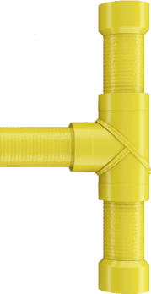
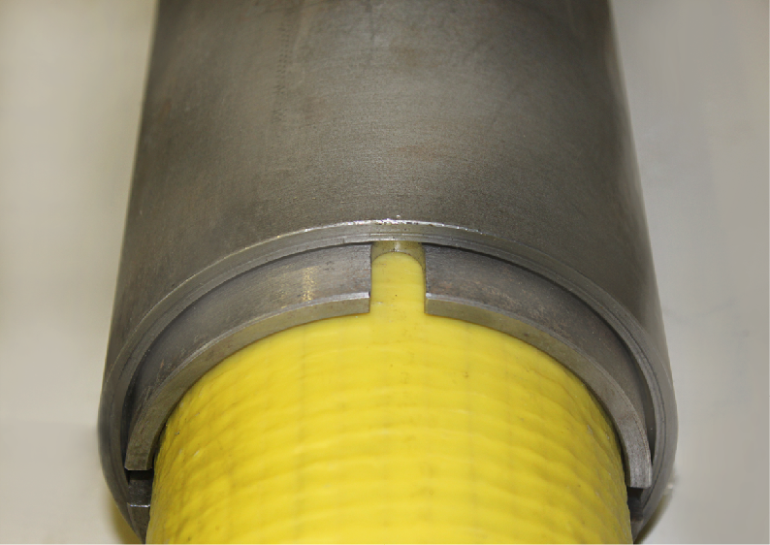
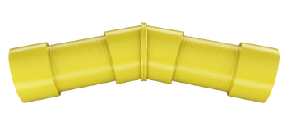
OUR PRODUCTS
Current production and short characteristics:
PRODUCT | OUTER DIAMETER, MM | INNER DIAMETER, MM | WALL THICKNESS, MM | WIRE DIAMETER, MM | WEIGHT, KG
MRPP 95 | 95 | 72 | 11,5 | 3,0 | 6,51
MRPP 115 | 115 | 92 | 11,5 | 3,0 | 8,51
MRPP 125 | 125 | 101 | 12,0 | 3,0 | 9,15
MRPP 140 | 140 | 116 | 12,0 | 3,0 | 10,22
MRPP 160 | 160 | 136 | 12,0 | 3,0 | 12,37
MRPP 180 | 180 | 155 | 12,5 | 3,0 | 13,50
MRPP 200 | 200 | 175 | 12,5 | 3,0 | 15,35
MRPP 225 | 225 | 200 | 12,5 | 3,0 | 17,58
MRPP 250 | 250 | 224 | 13,0 | 3,5х3,0 | 21,00
MRPP 275 | 275 | 251 | 14,5 | 4,0х3,0 | 27,00
From 95 to 275 mm
Supporting products:
Elbows for 15, 30, 45, 60 и 90°
Equal and unequal T-like fittings
Special indetachable switch to metal pipe

Slide 5



OUR TECHNOLOGY
Our technology is based on 3 major features:
Continuous production process with one extruder, operating automatically production process is faster
2-sided shock cooling system prevents the appearance of rough crystallized structures at macromolecular level
Calibration by inner diameter glance inner surface. Decreases flow resistance significantly
Possible transitions in technology:
Possibility to change metal wire size and shape
Possibility to change cell dimensions
Possibility to change polymers for different characteristics
Polyethylene
Polypropylene
Polyamide
Polyetherketone
Polyurethane
2 mm
5,5 mm
Belt shape

Slide 6
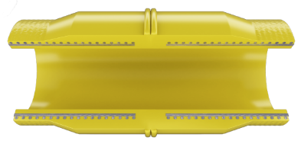
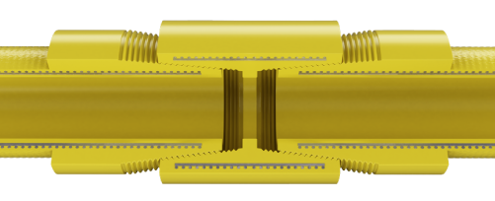
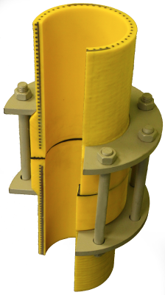
JOINING SOLUTIONS AND COUPLINGS
Joining solutions that are used for pipelining
Welded joint
Protects the metal frame from corrosion
As easy to maintain as regular polymer pipes
Regular equipment used
Joint is as strong as the pipe body
Easy to check the quality of the joint
Reinforced threaded joint
Can be produced with conic and cylindrical thread
Detachable and indetachable
Possibility of multiple use
Easy to handle with standard thread equipment
Successful application in casing, lifting and injection pipelines
Perfect durability
Flange joint
Regular steel flanges applied
Flexibility of applied flanges for different purposes
Flanges are placed before the edge tip is welded to a pipe
Easy connection with valves and other equipment
Possible to use for joining different types of pipes

Slide 7
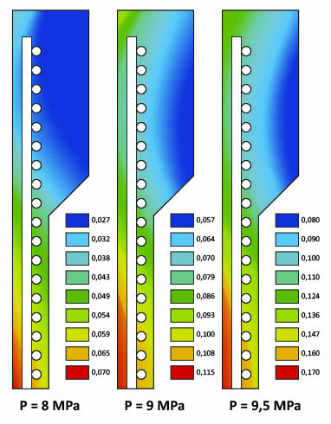
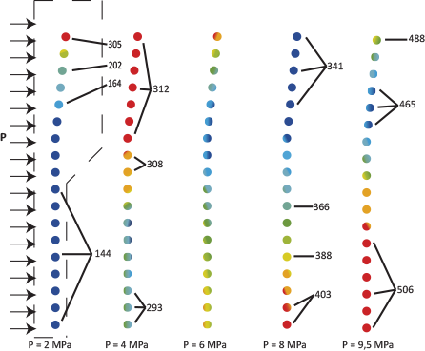
WELDED CONNECTION
Behavior of the polymer and the metal frame in the point of welded joint with the increase of the inner pressure to 9,5 MPa
Graphical illustration of stress increase in the polymer
Graphical illustration of stress increase in the transversal wire
Transversal wire bears 95% of the stress that occurs in the pipe wall with the increase of the inner pressure

Slide 8







APPLICATION AREAS AND HISTORY OF APPLICATION
MAJOR APPLICATION AREAS OF MRPP:
Oil extraction and oil and gas transportation.
Acids, alkalies, brine and brine slurry transportation
Underground and heap leaching of nonferrous and rare earth metals
Mining sector – transporting aggressive pulp (ore mixed with water)
Pipelines for water transportation, heating supply, drainage and other spheres of municipal services, gas circuits
Artesian boring as casing and lifting pipes
Transportation of salt water, seashore infrastructure, undersea pipelines, seashore reinforcement, ports and docks construction
HISTORY OF APPLICATION:

Slide 9
APPLICATION AREAS AND HISTORY OF APPLICATION
Our major historical application data for different industries:
Oil and gas industry
Pipelines for transportation of crude oil from the well to preparation node
Transportation of wet well highly corrosive product
Wells with high content of hydrogen sulphide
Oil pipelines in protected environmental zone
Gas distribution in rocky and hilly conditions
Chemical industry
Phosphoric fertilizers production
  Sulphuric acid with concentration from 0,5 to 50% and temperature up to 95°C
  Ortophosphoric acidwith concentration from 0,5 to 50% and temperature up to 95°C
Hydrofluoric acid with concentration of 10% and working temperature of 30 °C
Uranium and rare earth metals extraction
Uranium:
  Casing pipes
  Transportation of brine from the well to processing plant
Concrete injection into exhausted mine
Housing and public utilities
Cold water distribution
Hot water in-city distribution

Slide 10
ECONOMIC EFFICIENCY: COMPARISON ON THE RUSSIAN MARKET
Comparison of a life cycle cost for steel pipes and MRPP
Comparison of operating costs for 1 meter of pipe with 30 years of pipeline life cycle for MRPP-115 and substitutes, EUR*
Characteristics and assumptions | Steel pipe | MRPP
External diameter x wall thickness | 219 х 8 | 225 х 12,5
Price/meter, EUR* | 34,12 | 52,92
Guaranteed service life, years | 5 | 15
Expected service life, years | 15 | 45
Pipelining costs, % of the pipe cost | 60% | 15%
Anticorrosion treatment cost, % of the pipe cost | 25% | 0
Extra coating cost, % of the pipe cost | 20% | 0
Electro-chemical protection cost, % of the pipe cost | 2% | 0
Inhibitor protection, % of the pipe cost | 8% | 0
Pipeline service cost, % of the pipe cost | 10% | 10%
Annual discount rate, % | 8,25% | 8,25%
Inflation, % | 2,5% | 2,5%
Net Present Cost (NPC)¹, EUR* | 137,01 | 70,56
Service life cost, EUR* | 124,58 | 70,56
Durability, years | 15 years | 45 years
Comparison of operating costs for 1 meter of pipe with 30 years of pipeline life cycle for MRPP-225 and substitutes, EUR*
* All data is based on the prices in the Russian market as for 2013 and recalculated in Euro at the rate of 1 EUR = 60 RUB

Slide 11
ECONOMIC EFFICIENCY: COMPARISON ON THE RUSSIAN MARKET
Price comparison of MRPP and PE pipe SDR11 relative to diameter, EUR*:
* All data is based on the prices in the Russian market as for 2014 and recalculated in Euro at the rate of 1 EUR = 60 RUB

Slide 12
ECONOMIC EFFICIENCY: COMPARISON ON THE EUROPEAN MARKET
Comparison of the European market for different pipes
MRPP
External diameter | Wall thickness | Internal diameter
95 | 11,5 | 72
115 | 11,5 | 92
125 | 12 | 101
140 | 12 | 116
160 | 12 | 136
180 | 12,5 | 155
200 | 12,5 | 175
225 | 12,5 | 200
Polymer pipe PE 80
External diameter | Wall thickness | Internal diameter
110 | 15,1 | 79,8
125 | 17,1 | 90,8
140 | 19,2 | 101,6
160 | 21,9 | 116,2
180 | 24,6 | 130,8
225 | 30,8 | 163,4
250 | 34,2 | 181,6
280 | 38,3 | 203,4
Polymer Pipe, PE100
External diameter | Wall thickness | Internal diameter
110 | 15,1 | 79,8
125 | 17,1 | 90,8
140 | 19,2 | 101,6
160 | 21,9 | 116,2
180 | 24,6 | 130,8
225 | 30,8 | 163,4
250 | 34,2 | 181,6
280 | 38,3 | 203,4
Steel pipe (No Anti-Corrosion Cover)
External diameter | Wall thickness | Internal diameter
100 | 8 | 92
114,3 | 8 | 106,3
125 | 8 | 117
139,7 | 8 | 131,7
159 | 8 | 151
177,8 | 8 | 169,8
200 | 8 | 192
219,1 | 8 | 211,1
Inox 304
External diameter | Wall thickness | Internal diameter
100 | 8 | 92
114,3 | 8 | 106,3
125 | 8 | 117
139,7 | 8 | 131,7
159 | 8 | 151
177,8 | 8 | 169,8
200 | 8 | 192
219,1 | 8 | 211,1
* All data is based on the prices in the European market as for 2013 – beginning of 2014.

Slide 13
THANK YOU FOR YOUR ATTENTION

Slide 14
ADDENDUM: PHYSICAL & MECHANICAL PROPERTIES
 | Dimensions |  |  |  |  |  |  |  | Physical-mechanical properties
Product | External diameter, mm | Internal diameter, mm |  | Wall thickness, mm |  | Wire Diameter, mm | Weight, kg |  | Draft-end load, tnf (kN), not less than | Hermeticity under constant pressure during 1 hour, MPa (bar), not less than
MRPP 95 | 95 | 72 |  | 11,5 |  | 3,0 | 6,51 |  | 11,0 (110) | 11,5 (115)
MRPP 115 | 115 | 92 |  | 11,5 |  | 3,0 | 8,51 |  | 14,0 (140) | 11,5 (115)
MRPP 125 | 125 | 101 |  | 12,0 |  | 3,0 | 9,15 |  | 15,0 (150) | 11,5 (115)
MRPP 140 | 140 | 116 |  | 12,0 |  | 3,0 | 10,22 |  | 16,0 (160) | 10,5 (105)
MRPP 160 | 160 | 136 |  | 12,0 |  | 3,0 | 12,37 |  | 20,0 (200) | 7,5 (75)
MRPP 180 | 180 | 155 |  | 12,5 |  | 3,0 | 13,50 |  | 22,0 (220) | 7,5 (75)
MRPP 200 | 200 | 175 |  | 12,5 |  | 3,0 | 15,35 |  | 24,0 (240) | 7,0 (70)
MRPP 225 | 225 | 200 |  | 12,5 |  | 3,0 | 17,58 |  | 28,0 (280) | 7,0 (70)
MRPP 250 | 250 | 224 |  | 13,0 |  | 3,5х3,0 | 21,00 |  | 31,0 (310) | 7,0 (70)
MRPP 275 | 275 | 251 |  | 14,5 |  | 4,0х3,0 | 27,00 |  | 39,0 (390) | 7,0 (70)
Physical-mechanical properties (continued)
Product | Impact strength, kj/m² |  | Fatigue ration, 1*10⁷ cycles |  | Amount of cyclic loads under 0,4 MPa and 25 Hz |  |  | Thermal expansion coefficient |  | Ultimate stress MPa (bar), not less than
MRPP 95 | 427,4 |  | 0,46 |  | 3х10⁶ |  |  | 2х10⁻⁵ |  | 19,0 (190)
MRPP 115 |  |  |  |  |  |  |  |  |  | 15,0 (150)
MRPP 125 |  |  |  |  |  |  |  |  |  | 14,0 (140)
MRPP 140 |  |  |  |  |  |  |  |  |  | 13,0 (130)
MRPP 160 |  |  |  |  |  |  |  |  |  | 11,5 (115)
MRPP 180 |  |  |  |  |  |  |  |  |  | 10,0(100)
MRPP 200 |  |  |  |  |  |  |  |  |  | 9,0 (90)
MRPP 225 |  |  |  |  |  |  |  |  |  | 8,0 (80)
MRPP 250 |  |  |  |  |  |  |  |  |  | 8,0 (80)
MRPP 275 |  |  |  |  |  |  |  |  |  | 8,0 (80)

